Slide 1

EXPLAINABLE CLASSIFICATION OF X-RAY IMAGES USING BAYESIAN DEEP
LEARNING
Angelos Daglaroglou (s202915), Sophie Vilter (s212403)

Slide 2
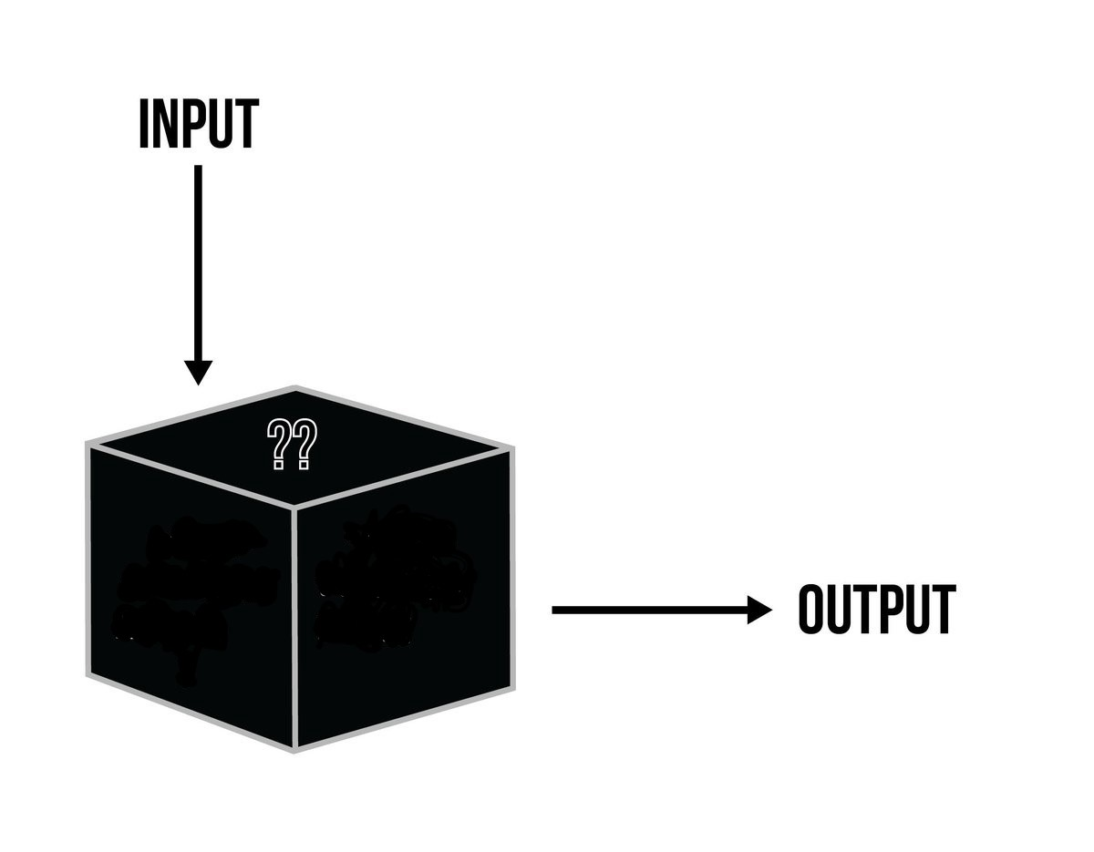
1. Introduction
Explore methods that improve explainability of a neural network regarding its decision making process.
Investigate how incorporating uncertainty analysis impacts model prediction interpretations.

Slide 3
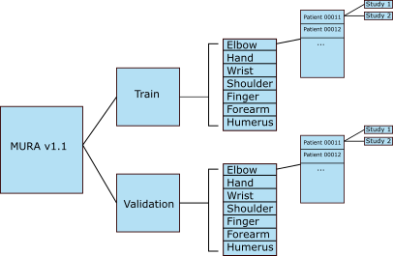
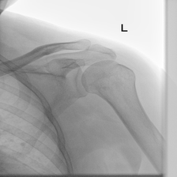
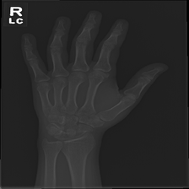
2. Data
X-ray images of upper body limbs
14.863 studies of 12.173 patients
36.808 training images and 3.197 test images
Fig 1. Shoulder
Fig 2. Hand
Fig 3. Data Structure

Slide 4
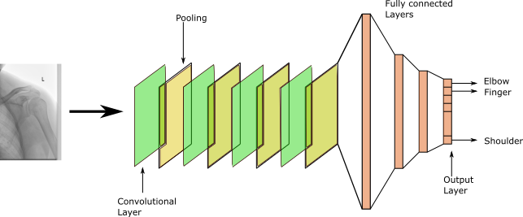
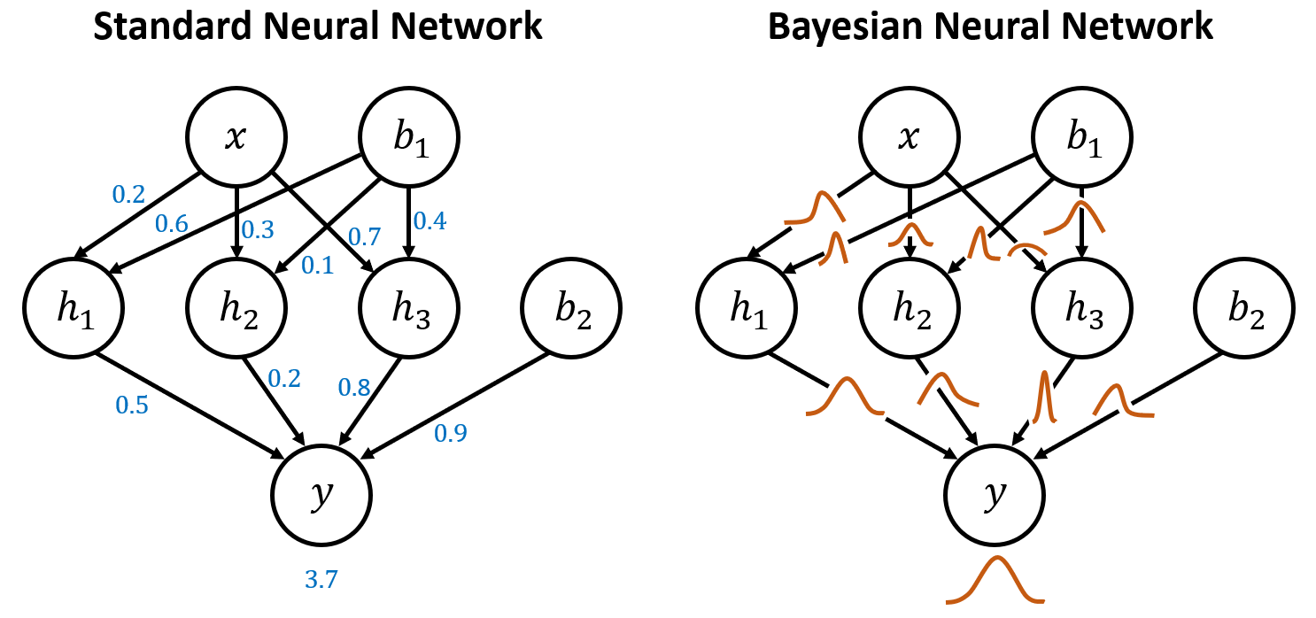
3. Models
Convolutional Neural Network
Four layers
REctified Linear Unit Activation (ReLU)
Cross Entropy Loss Criterion, Adam optimizer
Class Activation Maps
Visualize relavant features
Bayesian Neural Network
Estimate weight posterior distribution
Fig 1. CNN Structure
Fig 2. Bayesian Translation

Slide 5
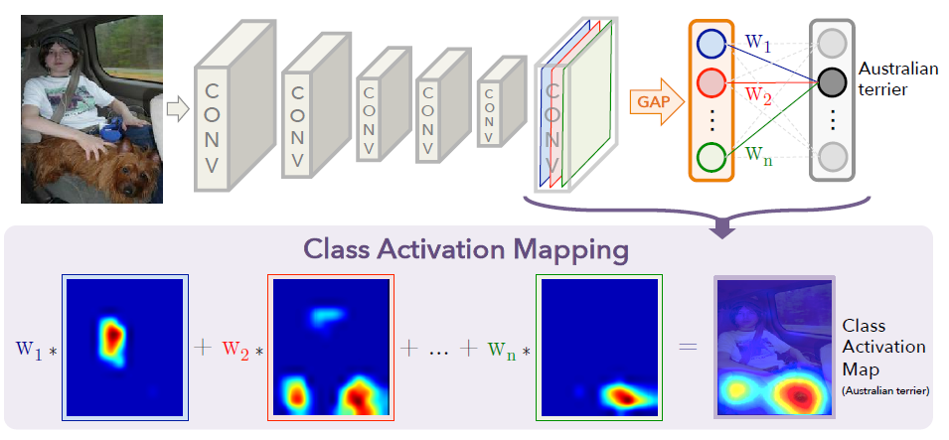
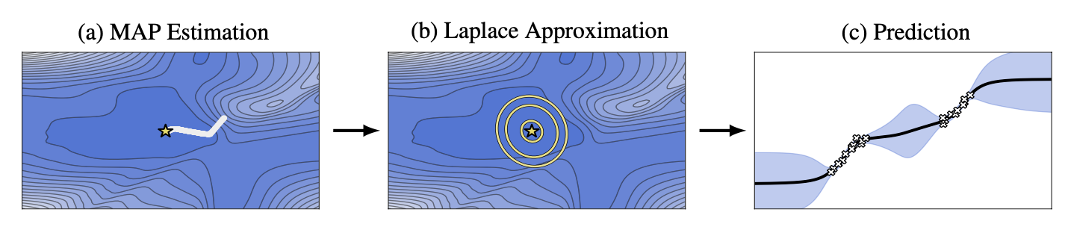
4. Computation
Convolutional Neural Network
Maximum a-posteriori
Class Activation Map
Global Average Pooling
Bayesian Neural Network
Laplace Approximation
Hessian Matrix
Fig 1. CAM structure
Fig 2. Visualising Laplace

Slide 6
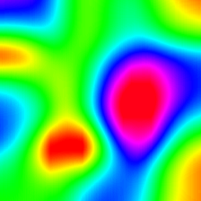
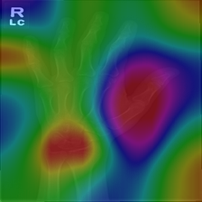
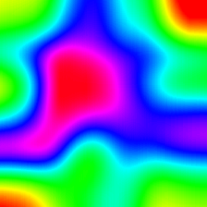
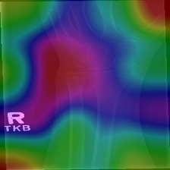
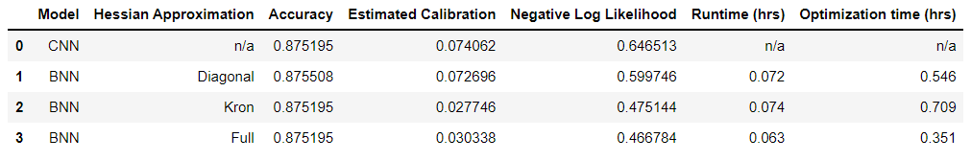
5. Results
Not really fast (especially diagonal approximation)
No improvement in Accuracy
Estimated Calibration Error improved signifficantly
Negtive Log Likelihood error improved
Fig 1. Heatmap and CAM images for Hand (Top) and wrist (bottom) x-rays

Slide 7
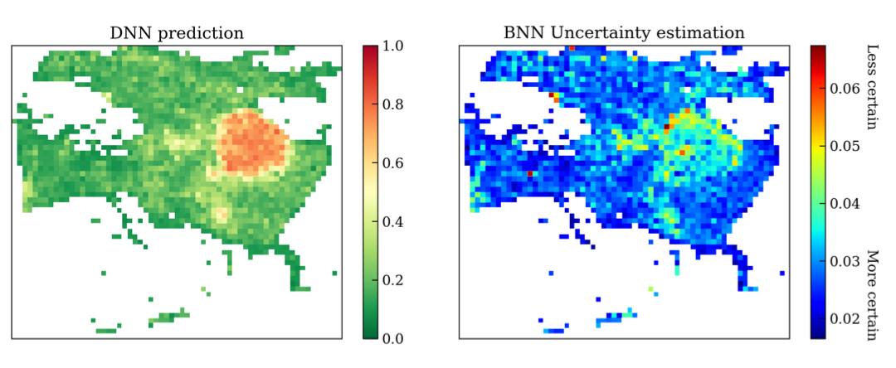
6. Next steps
Apply transformation in different Neural Networks
Try on more complicated problems (and compare results)
Evaluate certainty of regions' significance
Fig 1. Uncertainty applied to CAM

